Slide 1
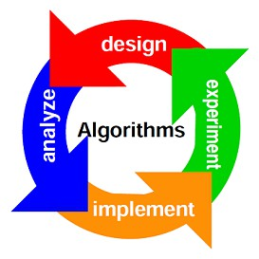
Course Code: 19CSC214A
Course Title: Design and Analysis of Algorithms
Course Leader:
Dr. Aruna Kumar S V
Arunakumar.cs.et@msruas.ac.in

Slide 2

Dr. Aruna Kumar S V
Ph. D., VTU, 2018
Asst. Prof. NMAMIT, Nitte
Post-Doc Researcher, UBI, Portugal
Research interests:
Biometrics
Medical Image Processing
Machine Learning
https://scholar.google.com/citations?user=FAqiuW0AAAAJ&hl=en
www.researchgate.net/profile/S_V_Aruna_Kumar
Arunakumar.cs.et@msruas.ac.in

Slide 3
Design and Analysis of Algorithms

Slide 4

What is Algorithm?

Slide 5
History of Algorithm
The word algorithm comes from the name of a Persian author, Abu Ja’far Mohammed ibn Musa al Khowarizmi (c. 825 A.D.), who wrote a textbook on mathematics.
He is credited with providing the step-by-step rules for adding, subtracting, multiplying, and dividing ordinary decimal numbers.
When written in Latin, the name became Algorismus, from which algorithm is but a small step

Slide 6
History of Algorithm
This word has taken on a special significance in computer science, where “algorithm” has come to refer to a method that can be used by a computer for the solution of a problem
Between 400 and 300 B.C., the great Greek mathematician Euclid invented an algorithm

Slide 7

Why do you need to study algorithms?
7
©M. S. Ramaiah University of Applied Sciences
© Ramaiah University of Applied SciencesFaculty of Engineering & Technology

Slide 8
Why do you need to study algorithms?
Practical Reasons:
you have to know a standard set of important algorithms from different areas of computing; in addition, you should be able to design new algorithms and analyze their efficiency.
Theoretical Reasons:
The study of algorithms, sometimes called algorithmics, has come to be recognized as the cornerstone of computer science.

Slide 9
Why do you need to study algorithms?
David Harel, in his delightful book pointedly titled
Algorithmics: the Spirit of Computing, put it as follows:
“Algorithmics is more than a branch of computer science. It is the core of computer science, and, in all fairness, can be said to be relevant to most of science, business, and technology”.

Slide 10
More Importantly….
Usefulness in developing analytical skills:
After all, algorithms can be seen as special kinds of solutions to problems—not just answers but precisely defined procedures for getting answers. Consequently, specific algorithm design techniques can be interpreted as problem solving strategies that can be useful regardless of whether a computer is involved.
Of course, the precision inherently imposed by algorithmic thinking limits the kinds of problems that can be solved with an algorithm. You will not find, for example, an algorithm for living a happy life or becoming rich and famous.

Slide 11
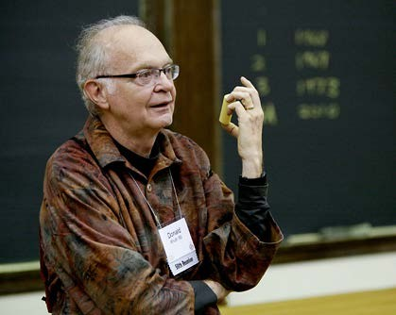
In Addition…
“A person well-trained in computer science knows how to deal with algorithms: how to construct them, manipulate them, understand them, analyze them. This knowledge is preparation for much more than writing good computer programs; it is a general-purpose mental tool that will be a definite aid to the understanding of other subjects, whether they be chemistry, linguistics, or music, etc. The reason for this may be understood in the following way: It has often been said that a person does not really understand something until after teaching it to someone else. Actually, a person does not really understand something until after teaching it to a computer, i.e., expressing it as an algorithm . . . An attempt to formalize things as algorithms leads to a much deeper understanding than if we simply try to comprehend things in the traditional way.”
Donald Nuth

Slide 12
Examples

Slide 13

To make a cup of tea?

Slide 14
To make a cup of tea
Add water and milk to the kettle,
Boil it, add tea leaves,
Add sugar, and then serve it in cup.
very difficult for a machine to know how much water, milk to be added etc. in the above tea making algorithm.

Slide 15
Design and Analysis of Algorithms
Design: Design algorithms which minimize the cost
Analysis: predict the cost of an algorithm in resources and performance
terms of
Algorithm:

